Slide 1
Adventures with the A-Word:
Advocacy Planning at ALA
Marci Merola, Director
ALA Office for Library Advocacy
Oregon Library Assn. Executive Board Meeting
October 3, 2014

Slide 2
How do you
define advocacy?

Slide 3
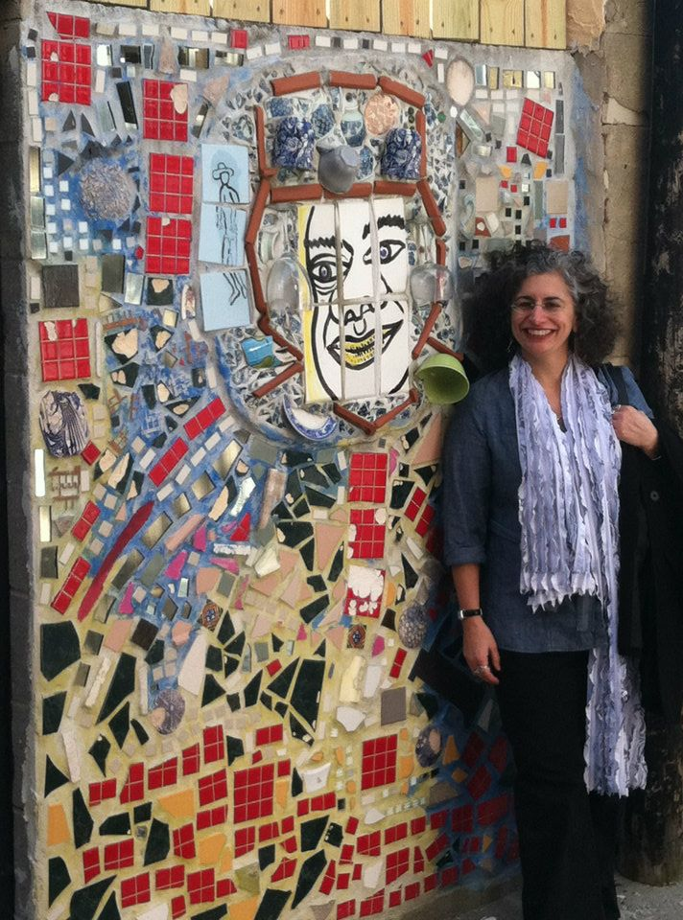
The Office for Library Advocacy
The Office for Library Advocacy (OLA) supports the efforts of advocates seeking to improve libraries of all types by developing resources, a peer-to-peer advocacy network, and training for advocates at the local, state and national level.
In order to achieve this goal, OLA works closely with the Public Information Office, the Chapter Relations Office, the Office for Government Relations, and other ALA units involved in advocacy on behalf of particular types of libraries or particular issues, in order to help better integrate these efforts into the overall advocacy planning and strategies of the association.
OLA also works to cultivate future leadership in order to sustain the advocacy efforts of the association.

Slide 4
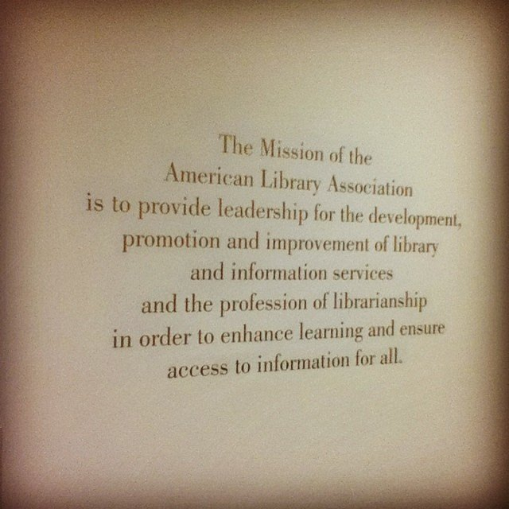

Slide 5
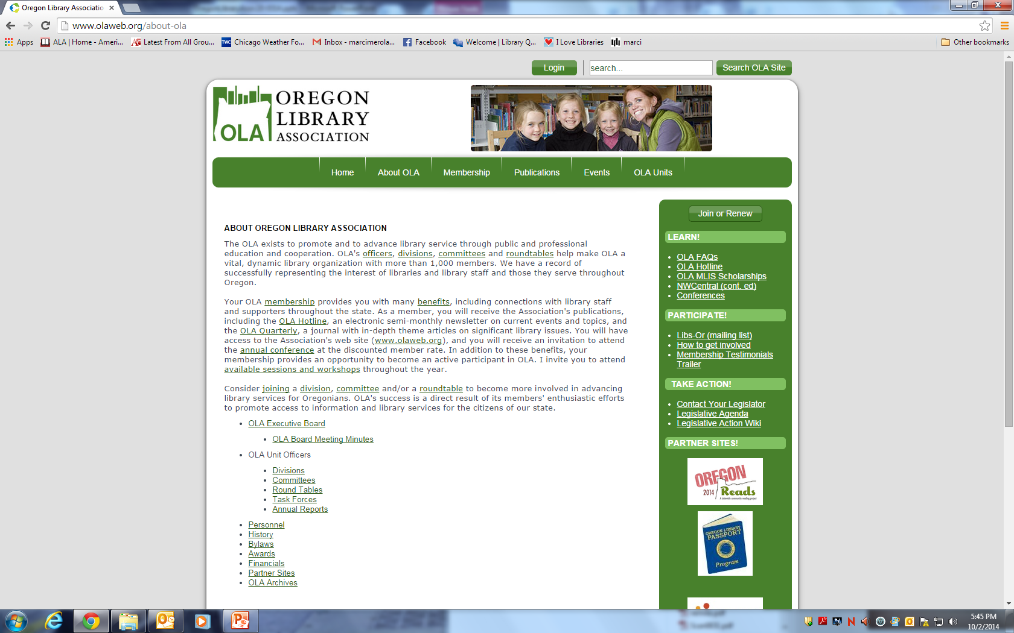

Slide 6
Advocacy
Advocacy: Turning passive support into educated action.
Or: turning support into action.

Slide 7
…vs. Public Awareness
Public Awareness: Efforts to inform a given public about a particular issue or idea.

Slide 8
…vs. lobbying
Lobbying: to try to influence the thinking of legislators or other public officials for or against a specific cause.

Slide 9
Lobbying
Advocacy
Public Awareness

Slide 10
Library Service vs.Value of Libraries
(users vs. supporters)
Notes:
.

Slide 11
Strategic Plan

Slide 12
ALA’s three new strategic areas
Advocacy
Information Policy
Professional Development
Notes:
.

Slide 13
Strategic Plan

Slide 14
Visioning Questions
If we are doing advocacy and public awareness correctly, what is different for libraries five years from now? For librarians? For the Association?
What tactics and strategies do we have to employ to get to that point?
What are our goals?

Slide 18
Strategic Plan Components:
Advocacy Vision
Goals/Objectives/Strategies/Metrics
Framework (advocacy continuum)
Program Portfolio
Annual Action Plans

Slide 19
Thank you, OLA!
Marci Merola, Director
ALA Office for Library Advocacy
mmerola@ala.org

